Slide 1

NPN Switch
Mark Emerson RBT 125 UAT Feb 2024

Slide 2
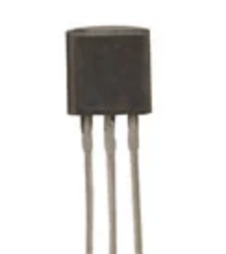
NPN Switch -
An NPN switch is a transistor-style switch that can be used in conjunction with a push-button switch to complete a secondary circuit that works in conjunction with the main circuit. It allows for a larger voltage or amperage to be switched on or off with the application of a lower voltage in a separate switch. This can be demonstrated by a 24-volt system being turned on by a 9-volt battery in a push button switch. The NPN Switch is a 3-legged transistor that allows for 2 power inputs to be collected and share an operation.

Slide 3
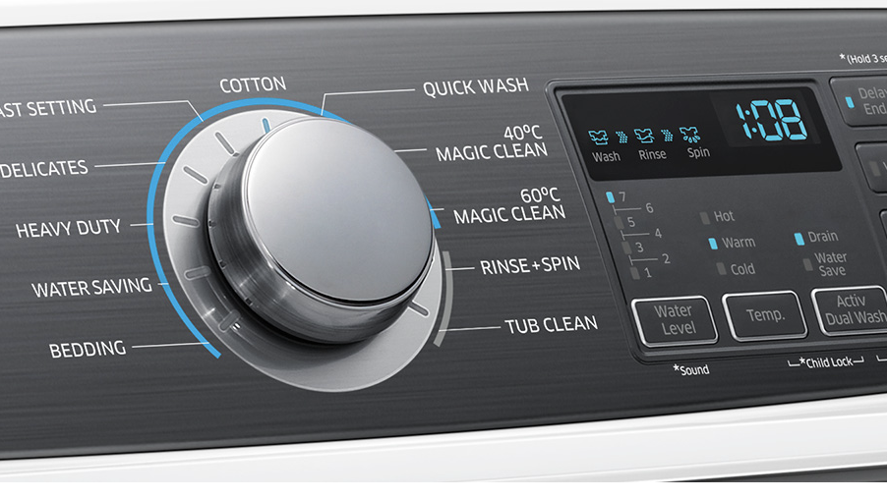
NPN Switch – Where are they used?
NPN Switches are commonly found in appliances where a small amount of voltage is needed to activate a motor outside of a switch directly controlling the motor. This can be items such as a washing machine, dishwasher or some older radios. A small amount of current from the dial is applied to close the circuit for the motor to start working. This allows lower voltage at the switch interaction point.

Slide 4
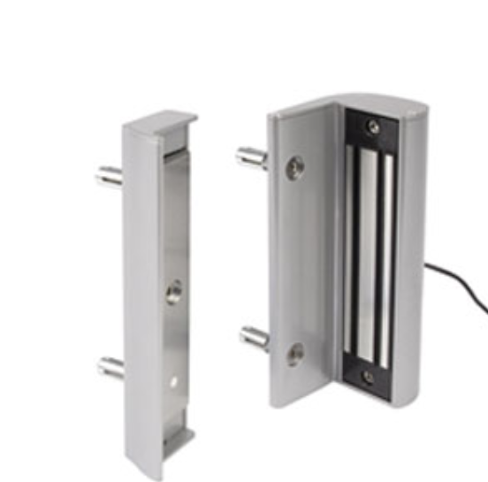
Benefits of NPN -
Safety – Remote operations of switches
Size – NPN switches are small and can be incorporated into many different electrical applications
Established voltage levels – The main switch can only be opened when NON switch voltage is at a certain level. If it drops below that the main circuit opens.

Slide 5
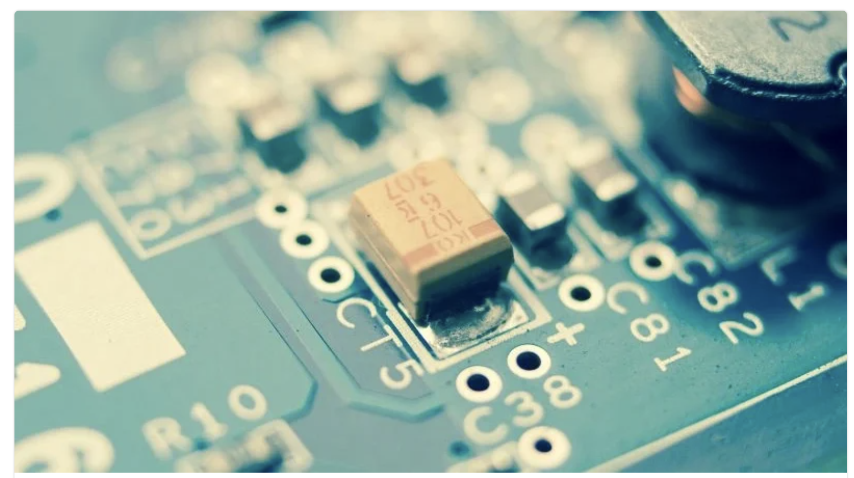
Disadvantages of NPN
System operation – Low voltage or no voltage at the secondary switch can make the main switch inoperable.
Temperature Sensitive – NPN switches should be used in climate-controlled environments.
Component can be damaged if to much heat or voltage applied.

Slide 6
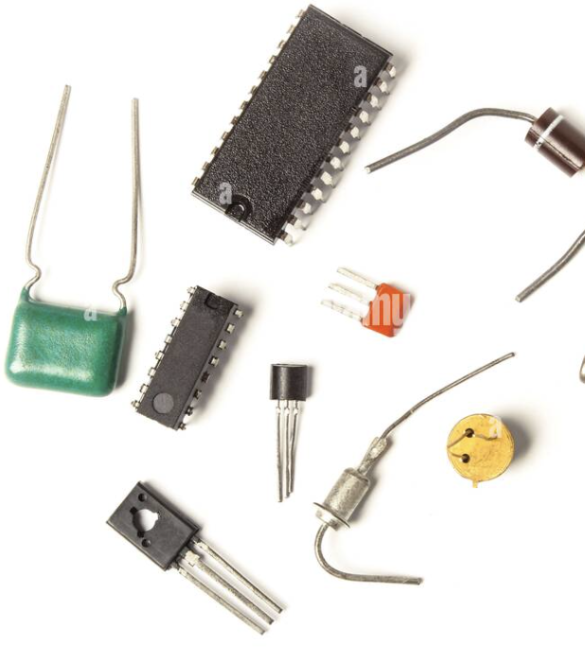
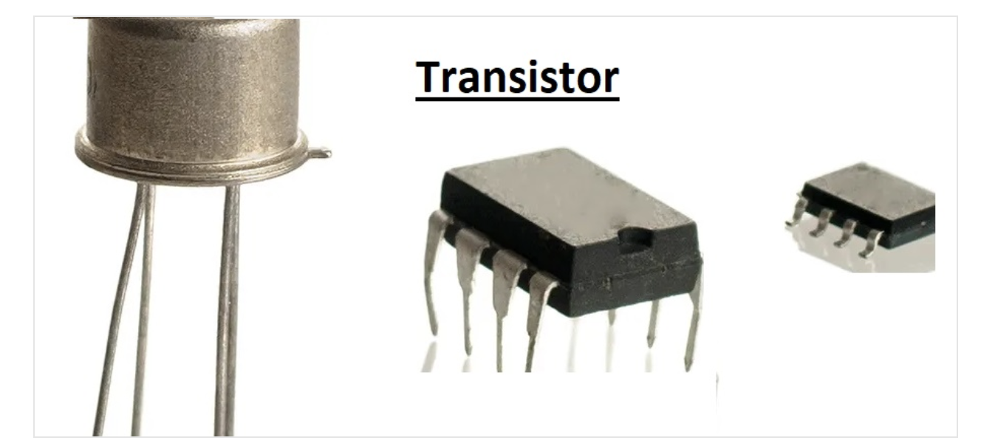
Variations of NPN
NPN switches can be found in printed cards
or inline switches

Slide 7
References:
BLOM, J. (2024, February 11). Sparkfun. Retrieved from
sparkfun.com: https://learn.sparkfun.com/tutorials/transistors/applications-i-switches
DIY Engineers. (2024, February 11). BC547 NPN Transistor as a Switch - Arduino Example with LED Flash.
Retrieved from Youtube: https://www.youtube.com/watch?v=-o46f7fIX9A
Electrotec. (2024, February 11). How an NPN Transistor Works.
Retrieved from Youtube.com: https://www.youtube.com/watch?app=desktop&v=vezptJWVqtg

